Slide 1

Project 4 Group 3
House Price Prediction using various ML techniques

Slide 2
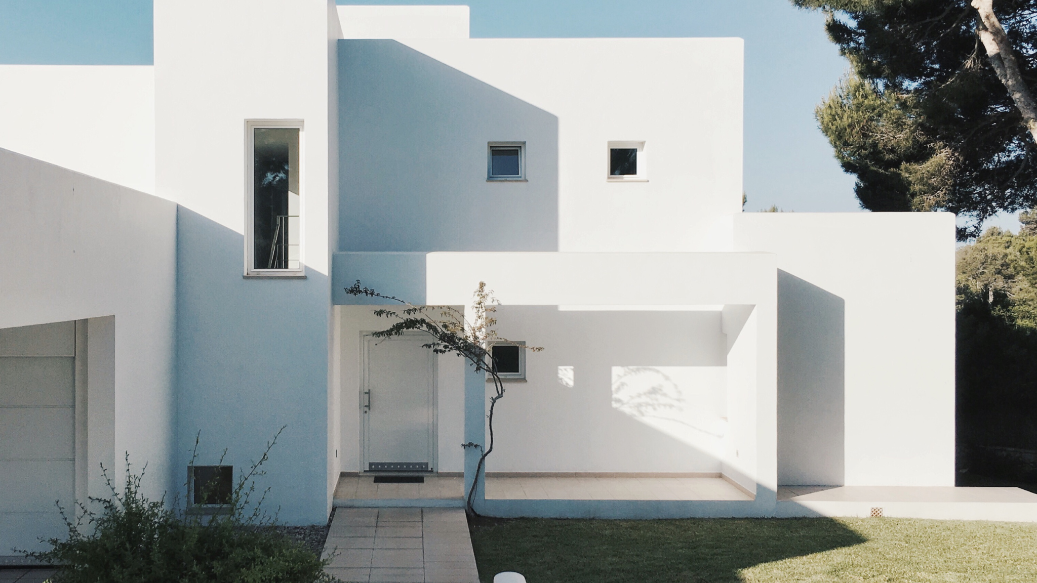
2010
Ames, Iowa
Population 58,965,
U.S. Census Bureau

Slide 3
Table Of Contents
Data Collection
Visualization
Talk about the process
Findings
01.
03.
02.
04.
Introductions
Analysis
Introduce the team Project Overview .
Predicting House prices

Slide 4



Meet Our Team
Manuel Sosa
Adams Olweny
Dawn Reynoso

Slide 5

Our
Project
This project focuses on developing a predictive model for housing prices using various machine learning techniques.
The primary goal is to accurately predict house sales prices based on a comprehensive dataset that includes numerous features related to property characteristics such as area, quality, condition, and location.

Slide 6

Project Questions
QUESTION ONE
Predict house prices based on a number of numerous features related to property characteristics ?
QUESTION TWO
Which variables have a strong correlation to the house price?
QUESTION THREE
Which variables have the least correlation on the house price?

Slide 7
Resources
Data Resource:
Kaggle.com
Tech Stack:
GitHub
Google Colaboratory
Google Docs
Matplotlib
NumPy
Pandas
Seaborn
Sklearn
Tableau
General Resources
City of Ames
Iowa State Daily Newspaper
United States Census Bureau

Slide 8

Welcome To Ames, Iowa
Forbes ranks Ames’ 20th
Forbes places Ames in the top 20 small metros nationwide.
October 22, 2009

Slide 9
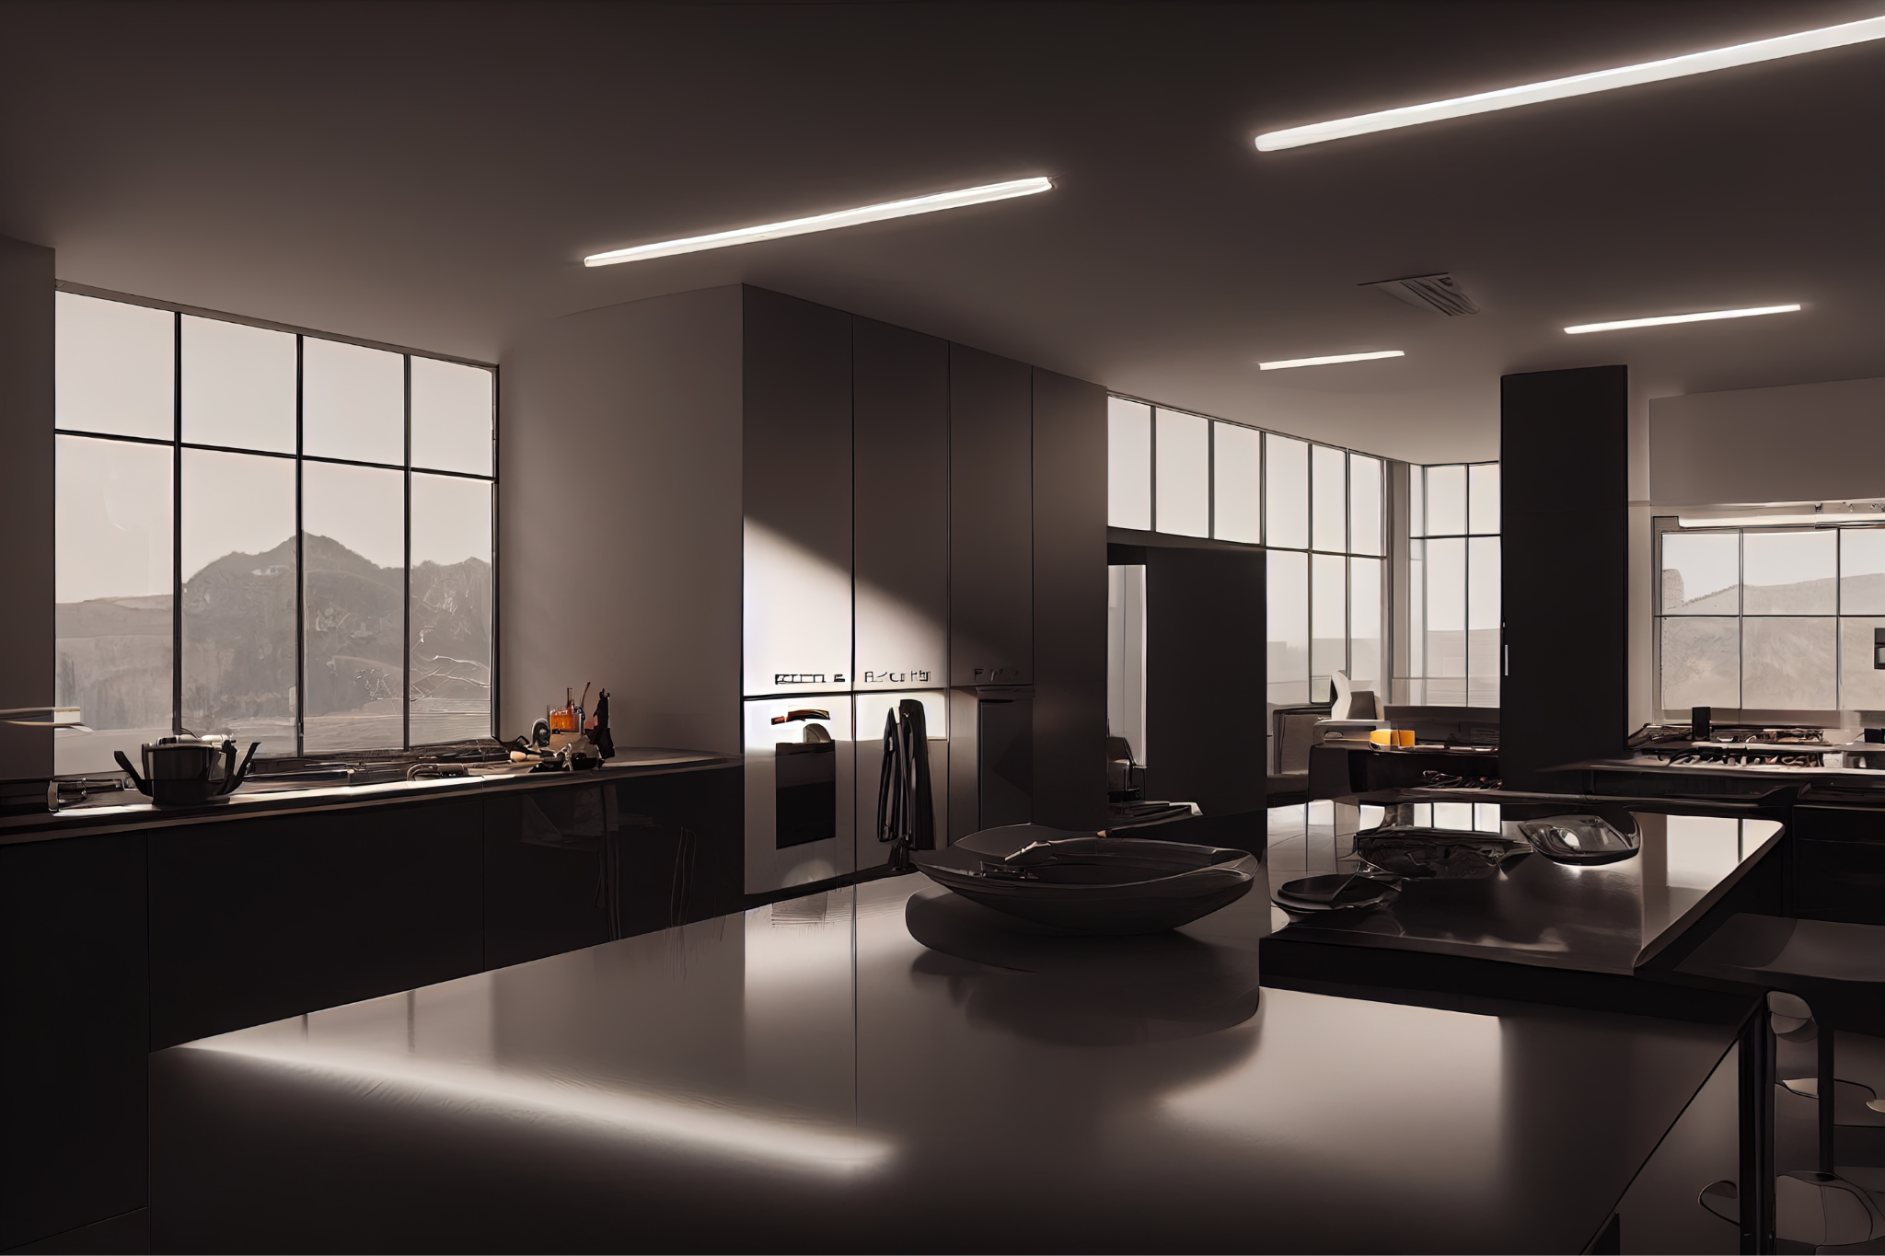

About Ames, IA
Location
Colleges
Ames Living
30 miles North of
Des Moines, IA
Known as the heart of the Midwest and Iowa
Known as the home of Iowa State University.
Leading Agriculture, Design, Engineering and Veterinary Medicine College

Slide 10

02.
Data Collection
Collect and store data
Clean and prepare

Slide 11
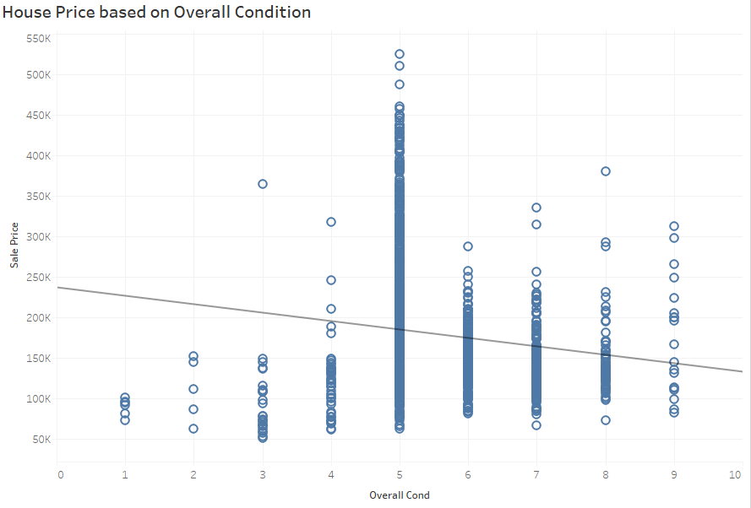
House Price Based on Overall Condition
P-Value: <0.0001
Equation: Sale Price = -10511.2*Overall Cond +237637
Coefficients Term Value StdErr t-value p-value
Overall Cond -10511.2 1750.93 -6 .00323 <0.0001
Intercept 2376379932.61 23.9249 <0.0001

Slide 12
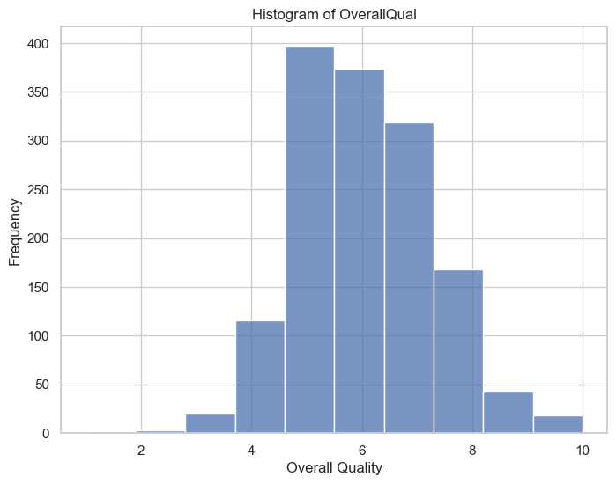
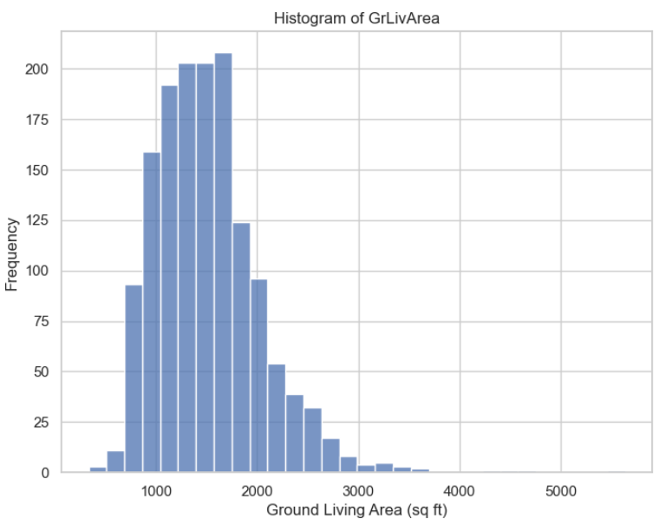
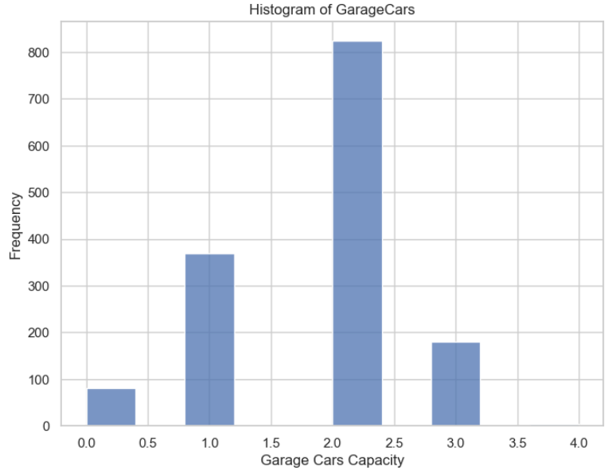
Histograms
Overall Quality
Ground Living Area (sq ft)
Garage Car Capacity

Slide 13

03.
Data Analysis
Investigation, Examination, and Data Exploration

Slide 14
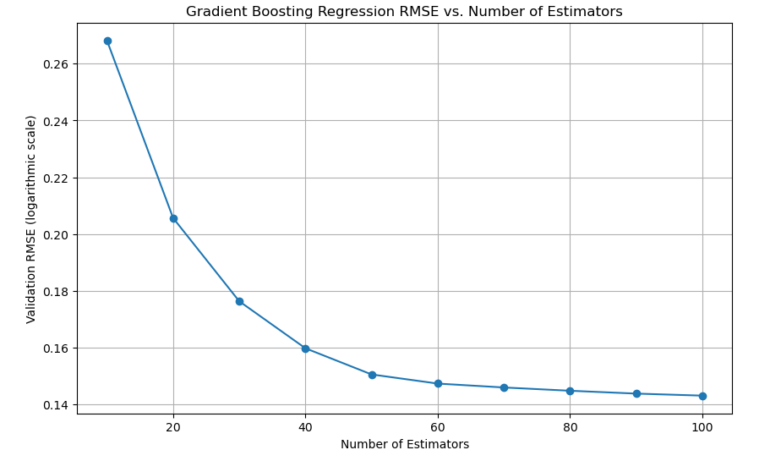
Gradient Boosting Regression RMSE vs. Number of Estimators
Performance: Best Performing model
Interpretation: This model has the lowest RMSE, indicating it has the best predictive accuracy among the models listed. Gradient Boosting effectively handles both linear and non-linear relationships by building an ensemble of weak prediction models, typically decision trees.
Gradient Boosting Regression Validation
Validation RMSE with 10 estimators: 0.2682241739221871
Validation RMSE with 20 estimators: 0.2056552874557367
Validation RMSE with 30 estimators: 0.1763117248892716
Validation RMSE with 40 estimators: 0.159752564489652
Validation RMSE with 50 estimators: 0.15053158286110857
Validation RMSE with 60 estimators: 0.1473106597310198
Validation RMSE with 70 estimators: 0.1459401441930658
Validation RMSE with 80 estimators: 0.14478862706074833
Validation RMSE with 90 estimators: 014378061934064096
Validation RMSE with 100 estimators: 014306673994166472
Final Model Validation RMSE (logarithmic scale) :
0.14306673994166472

Slide 15
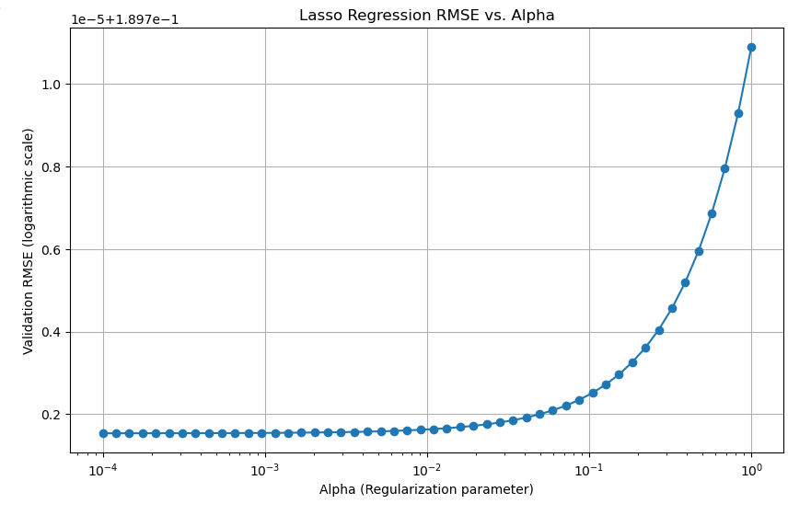
Lasso Regression Model
Performance: Joint second best with Random Forest.
Interpretation: Lasso (Least Absolute Shrinkage and Selection Operator) performs both variable selection and regularization to enhance the prediction accuracy. Its performance is strong, especially considering it helps in reducing overfitting in models with many features.
Validation RMSE
(logarithmic scale):
0.15404594833283894

Slide 16
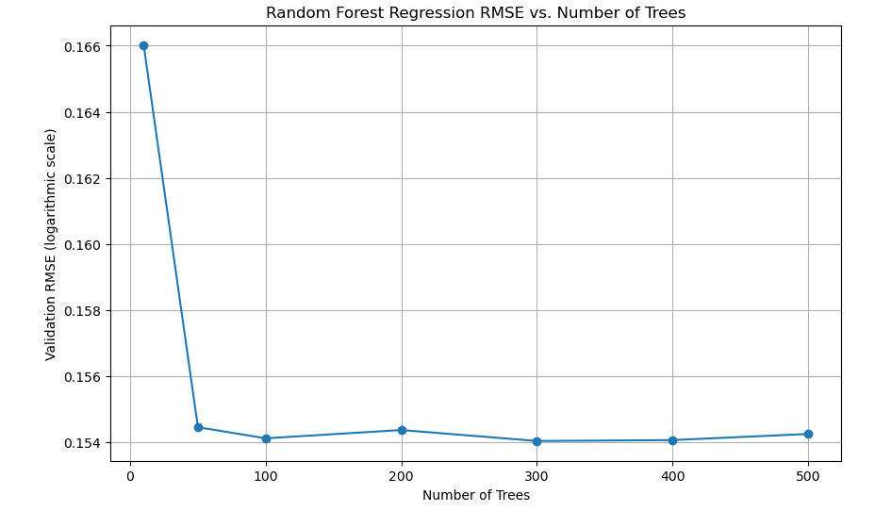
Random Forest Regressor Model & Random Forest Model
Performance: Very close to Lasso, almost identical RMSE for one variant.
Interpretation: Shows robust performance, slightly varied between implementations. Random Forest is effective due to its method of averaging multiple deep decision trees, trained on different parts of the same training set, which reduces overfitting and variance.
This probably means too few trees were used to compute any reliable OOB estimates.
OOB RMSE with 10 trees: 0.16602181485865006
OOB RMSE with 50 trees: 0.15446243375941687
OOB RESE with 100 trees: 0.15412655555084592
OOB RMSE with 200 trees: 0.15437734088082378
OOB RMSE with 300 trees: 0.15404594833283894
OOB RMSE with 400 trees: 0.15407258710041102
OOB RMSE with 500 trees: 0.15425770387121085
Best Model Validation RMSE
(logarithmic Scale) 0.15404594833283894

Slide 17
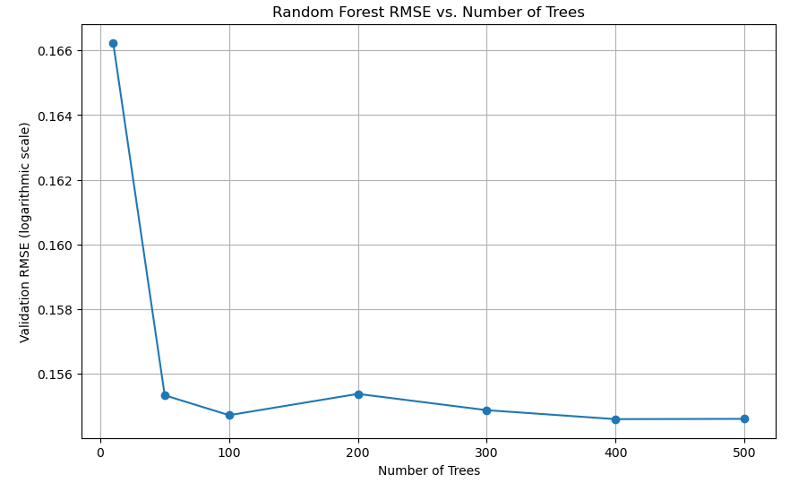
Random Forest Model
Final Model Validation RMSE (logarithmic scale): 0.15460513670456424
This probably means too few were used to compute any reliable OOB estimates.
Validation RMSE with 10 trees: 0.1662343720459083
Validation RMSE with 50 trees: 0.1553413724657581
Validation RMSE with 100 trees: 0.15472731915872182
Validation RMSE with 200 trees: 0.15538547182882992
Validation RMSE with 300 trees: 0.15488222094537213
Validation RMSE with 400 trees: 0.15460513670456424
Validation RMSE with 500 trees: 0.15461358292100666

Slide 18
Simple Average Blend
Performance: Mid-tier performance
Interpretation: This technique involves averaging the predictions of multiple models. It’s a straightforward ensemble method that can yield decent results by blending different model outputs, reducing variance but not always capturing complex patterns effectively.
Duality gap:1.423e+09, tolerance: 6.967e+08
Validation RMSE for simple average blend: 0.16307987309213423
Validation RMSE for linear regression blender: 26117.286407322554

Slide 19
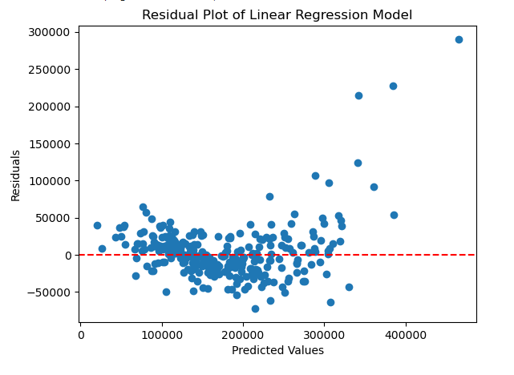
Linear Regression Model
Performance: Lower middle performance
Interpretation: Show moderate predictive power. Linear regression assumes a linear relationship between features and the target variable, which might not always hold true in complex datasets like house pricing, explaining the higher RMSE.
Validation RMSE (logarithmic scale): 0.1896561896891731

Slide 20
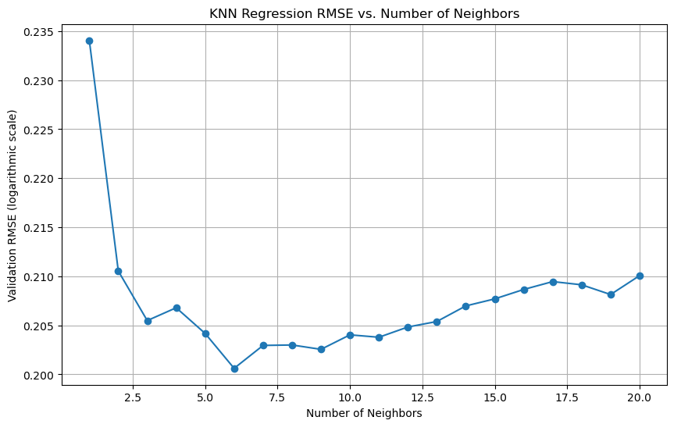
K-Nearest Neighbors Regressor Model
Performance: Lower Performance
Interpretation: This model uses feature similarity to predict values of new data points, which indicates it may struggle with high dimensional data or where feature scaling is not adequately managed.
Final Model Validation RMSE (logarithmic scale): 0.20061281158254307
KNN Regression RMSE
Validation RMSE with 1 Neighbors: 0.23405686642275
Validation RMSE with 2 Neighbors: 0.21054217941447706
Validation RMSE with 3 Neighbors: 0.20548274884018689
Validation RMSE with 4 Neighbors: 0.2067920275398134
Validation RMSE with 5 Neighbors: 0.20416957386690346
Validation RMSE with 6 Neighbors: 0.20061281158254307
Validation RMSE with 7 Neighbors: 0.20295044826961986
Validation RMSE with 8 Neighbors: 0.2029950516485167
Validation RMSE with 9 Neighbors: 0.20255122795744027
Validation RMSE with 10 Neighbors: 0.2040287445662583
Validation RMSE with 11 Neighbors: 0.2037839686424267
Validation RMSE with 12 Neighbors: 0.2048289413952637
Validation RMSE with 13 Neighbors: 0.20538864296318152
Validation RMSE with 14 Neighbors: 0.20697870283827793
Validation RMSE with 15 Neighbors: 0.2076969628884134
Validation RMSE with 16 Neighbors: 0.20865707622585344
Validation RMSE with 17 Neighbors: 0.20945931412209165
Validation RMSE with 18 Neighbors: 0.20913361959366603
Validation RMSE with 19 Neighbors: 0.20814051384155133
Validation RMSE with 20 Neighbors: 0.21006424394023987

Slide 21
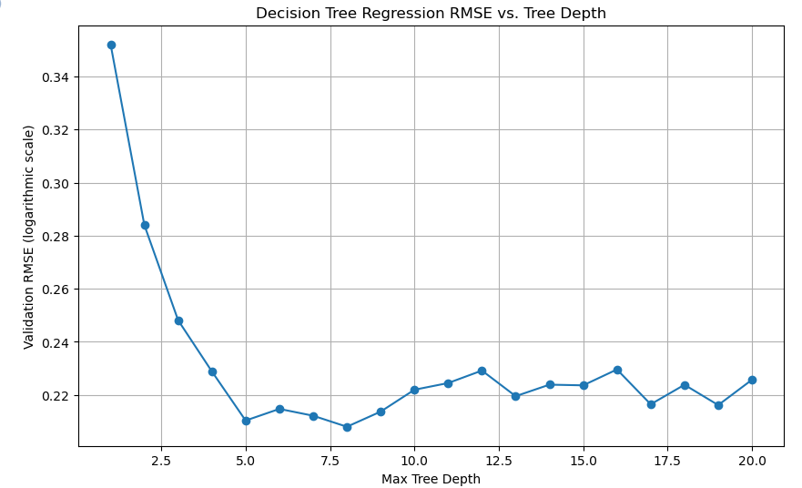
Decision Tree Regression RMSE vs Tree Depth
Performance: Lower performance among tree-based models.
Interpretation: Prone to overfitting, especially without adequate depth constraints or pruning. Decision Trees can capture complex patterns but often don’t generalize well.
Model Validation RMSE (logarithmic scale): 0.20798222834913374
Decision Tree Regression
Validation RMSE at depth 1: 0.3521368836643087
Validation RMSE at depth 2: 0.28401379937465826
Validation RMSE at depth 3: 0.2481311654079464
Validation RMSE at depth 4: 0.2288337144508904
Validation RMSE at depth 5: 0.2103224178957704
Validation RMSE at depth 6: 0.21470401749596218
Validation RMSE at depth 7: 0.2121392794141264
Validation RMSE at depth 8: 0.20798222834913374
Validation RMSE at depth 9: 0.21369103444749274
Validation RMSE at depth 10: 0.22193430650619692
Validation RMSE at depth 11: 0.22446158449060907
Validation RMSE at depth 12: 0.22916193798636852
Validation RMSE at depth 13: 0.2195071769978461
Validation RMSE at depth 14: 0.22384847264628738
Validation RMSE at depth 15: 0.22359163965436166
Validation RMSE at depth 16: 0.22957502198964397
Validation RMSE at depth 17: 0.21644742708553957
Validation RMSE at depth 18: 0.22380577214904987
Validation RMSE at depth 19: 0.2161507439971646
Validation RMSE at depth 20: 0.2256964961728966

Slide 22
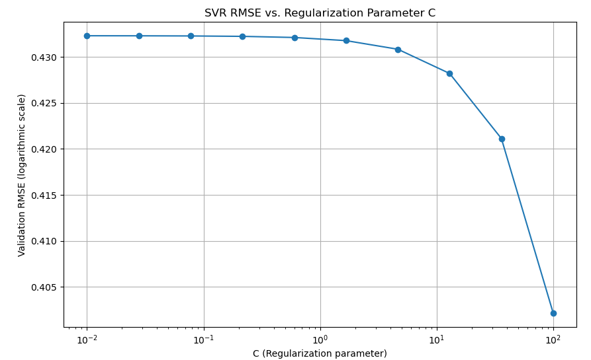
Support Vector Regression (SVR) Model
Performance: Worst performance.
Interpretation: This model, especially with default settings, many not perform well with large data sets or when features influencing the target are nonlinear. Its high RMSE suggests that it might not have captured the complex relationships in the data effectively.
SVR Model
Validation RMSE with: C=0.01:04.43228288619351873
Validation RMSE with: C=0.027825594022071243: 0.4322771977527251
Validation RMSE with: C=0.0774263682681127: 0.4322613912791919
Validation RMSE with: C=0.21544346900318834: 0.43221741006922215
Validation RMSE with: C= 0.5994842503189409: 0.43209503936337396
Validation RMSE with: C=1.6681005372000592: 0.43175461034100365
Validation RMSE with: C=4.6415888336127775: 0.43081992120251567
Validation RMSE with: C=12.915496650148826: 0.4281888182606385
Validation RMSE with: C=35.93813663804626: 0.42111674893938306
Validation RMSE with: C=100.0: 0.4021488535203938
Final Model Validation RMSE
(logarithmic scale: 0.4021488535203938

Slide 23
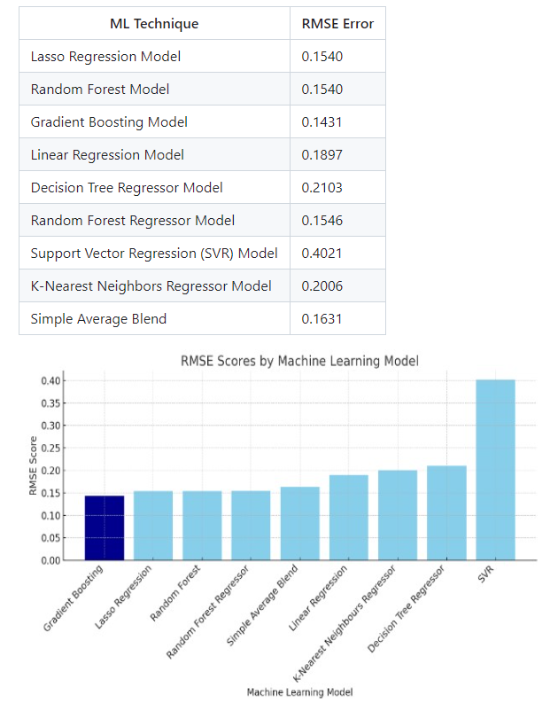
Performance Table

Slide 24
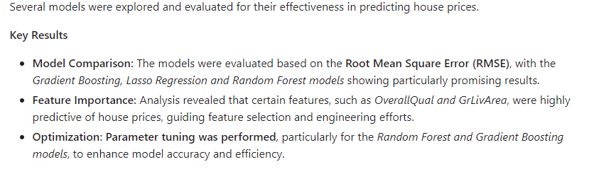
Results Summary

Slide 25
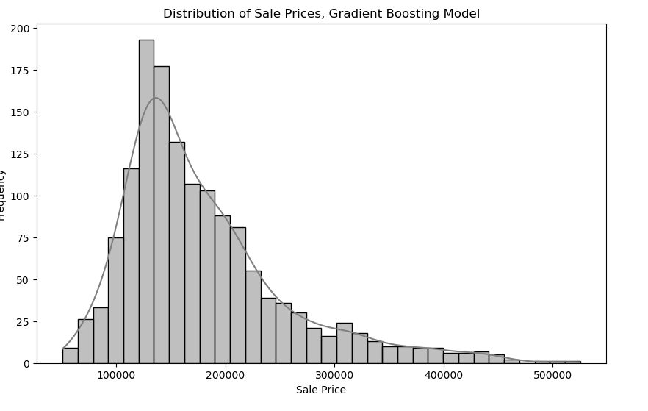
Histograms Distribution of Sale Prices
Gradient Boosting Model

Slide 26
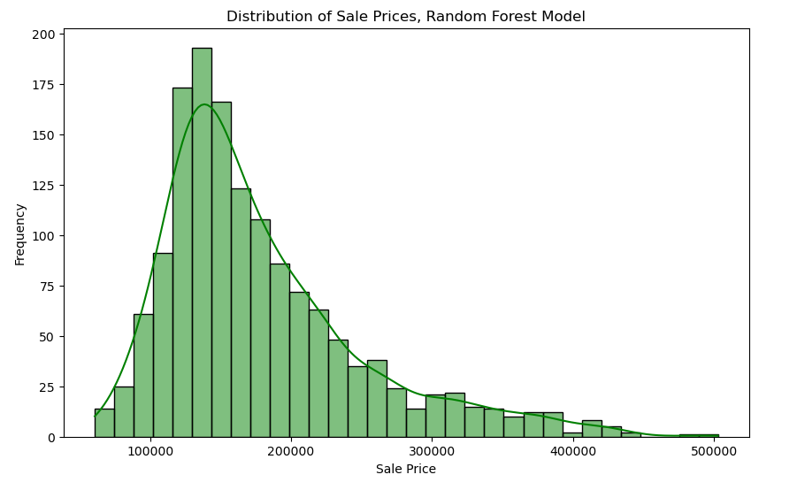
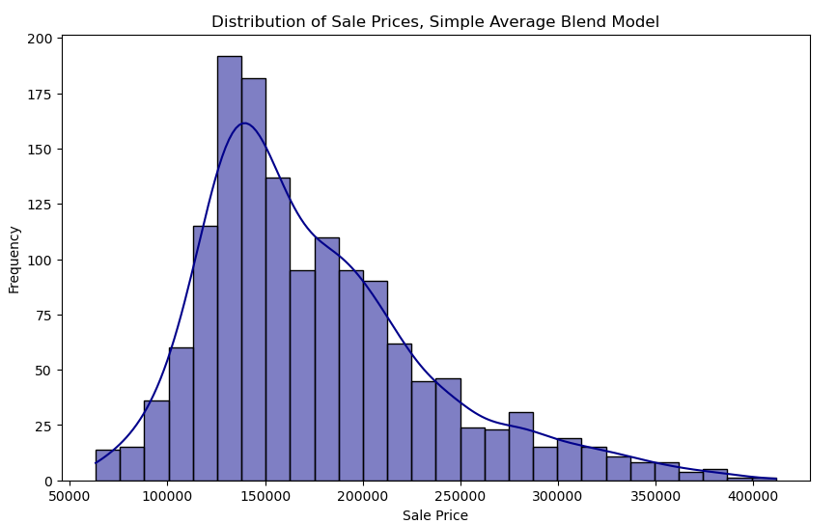
Histograms Distribution of Sale Prices
Random Forest Model
Simple Average Blend Model

Slide 27
Statistics Summary
Lasso Regression CSV file
Train CSV file
Id:
Count:1459.000000
Mean: 2190.000000
Std: 421.321334
Min: 1461.000000
25%: 1825.500000
50%: 2190.000000
75%: 2554.500000
Max: 2919.000000
SalePrice
1459.000000
177179.059440
70487.128423
1512.492405
127122.665759
167110.290895
222194.958299
592969.596198
Count: 1460.000000
Mean: 180921.195890
Std: 79442.502883
Min: 34900.000000
25%: 129975.000000
50%: 163000.000000
75%: 214000.000000
Max: 755000.000000

Slide 28
Statistics Summary
SVR CSV file
Forest Regressor CSV file
Decision Tree
CSV file
Id:
Count:1459.000000
Mean: 2190.000000
Std: 421.321334
Min: 1461.000000
25%: 1825.500000
50%: 2190.000000
75%: 2554.500000
Max: 2919.000000
SalePrice
1459.000000
164821.317446
6220.690832
152150.168626
159570.481540
164775.829086
170042.346979
177150.228918
Id:
Count:1459.000000
Mean: 2190.000000
Std: 421.321334
Min: 1461.000000
25%: 1825.500000
50%: 2190.000000
75%: 2554.500000
Max: 2919.000000
SalePrice
1459.000000
178757.312003
71372.729255
59723.125000
129153.836250
158048.197500
209538.311250
507914.827500
Id:
Count:1459.000000
Mean: 2190.000000
Std: 421.321334
Min: 1461.000000
25%: 1825.500000
50%: 2190.000000
75%: 2554.500000
Max: 2919.000000
SalePrice
1459.000000
178935.943480
77175.710269
57288.888889
128071.875000
159966.666667
204500.000000
745000.000000

Slide 29
Statistics Summary
Linear Regression CSV file
Gradient Boosting CSV file
Random Forest
CSV File
Id:
Count:1459.000000
Mean: 2190.000000
Std: 421.321334
Min: 1461.000000
25%: 1825.500000
50%: 2190.000000
75%: 2554.500000
Max: 2919.000000
SalePrice
1459.000000
177180.223345
70487.772118
1495.907874
127085.650626
167125.626787
222199.199332
593024.130582
Id:
Count:1459.000000
Mean: 2190.000000
Std: 421.321334
Min: 1461.000000
25%: 1825.500000
50%: 2190.000000
75%: 2554.500000
Max: 2919.000000
SalePrice
1459.000000
179160.223448
75159.616047
129071.970386
129071.970386
158581.564711
209158.547107
525118.711385
Id:
Count:1459.000000
Mean: 2190.000000
Std: 421.321334
Min: 1461.000000
25%: 1825.500000
50%: 2190.000000
75%: 2554.500000
Max: 2919.000000
SalePrice
1459.000000
178634.571177
71277.477837
58064.833333
129201.886667
158674.326667
209450.581667
505320.830000

Slide 30
Statistics Summary
Simple Average Blend CSV file
Linear Regression Blender CSV file
Id:
Count:1459.000000
Mean: 2190.000000
Std: 421.321334
Min: 1461.000000
25%: 1825.500000
50%: 2190.000000
75%: 2554.500000
Max: 2919.000000
SalePrice
1459.000000
180346.793854
79756.274062
44954.720963
127534.961159
157913.483581
211502.619365
547802.446063
Id:
Count:1459.000000
Mean: 2190.000000
Std: 421.321334
Min: 1461.000000
25%: 1825.500000
50%: 2190.000000
75%: 2554.500000
Max: 2919.000000
SalePrice
1459.000000
175737.696767
59198.422927
63279.938747
134227.905039
161448.876446
204910.133631
411529.889094

Slide 31

Summary
Missing Values and Data Completeness
Outliers' detections
Correlation between the Sale Price and Home Attributes
Distribution of Target Variable (Sale Price)
Impact of Features and Quality on the House Price

Slide 32
04.
Visualization

Slide 33
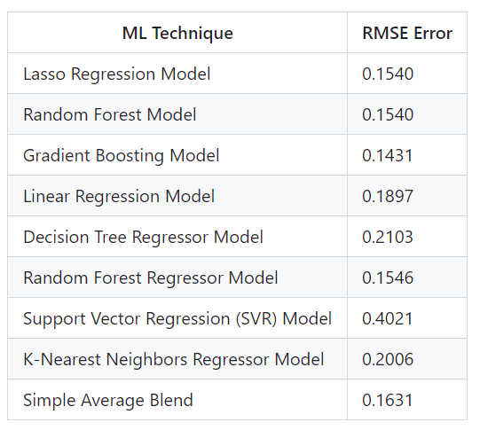
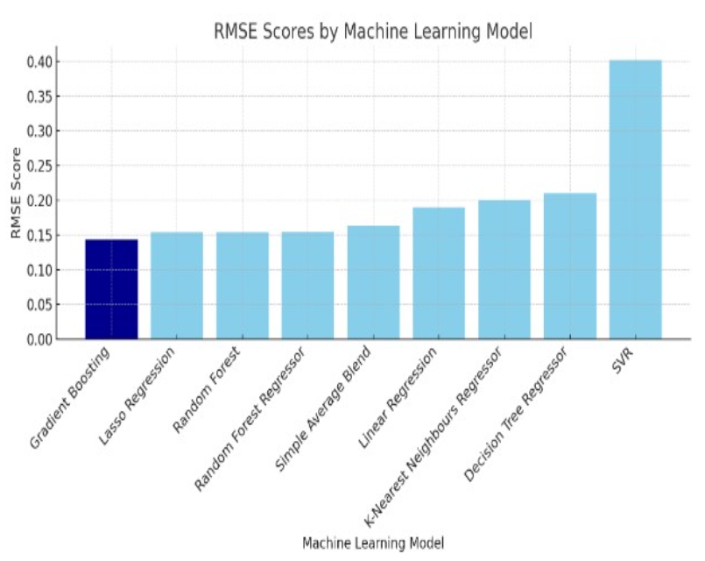
Results Summary
Model Comparison: The models were evaluated based on the Root Mean Square Error (RMSE), with the Gradient Boosting Lasso Regression and Random Forest model showing particularly promising results.
Feature Importance: Analysis revealed that certain features, such as OverallQual and GrLivArea, were highly predictive of house prices, guiding feature selection and engineering efforts.
Optimization: Parameter tuning was performed, particularly for the Random Forest and Gradient Boosting models, to enhance model accuracy and efficiency

Slide 34
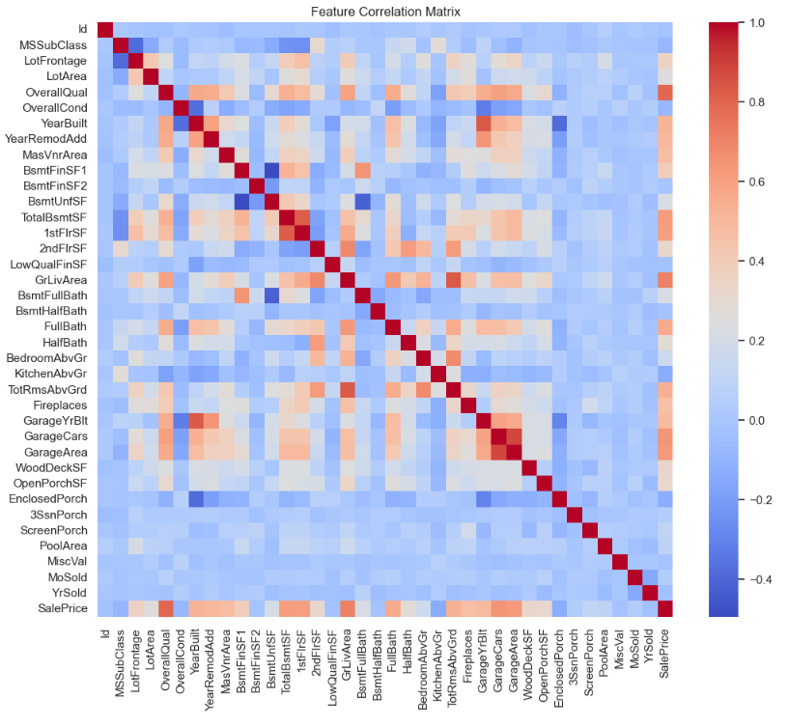
Heat Map Feature Correlation Matrix

Slide 35
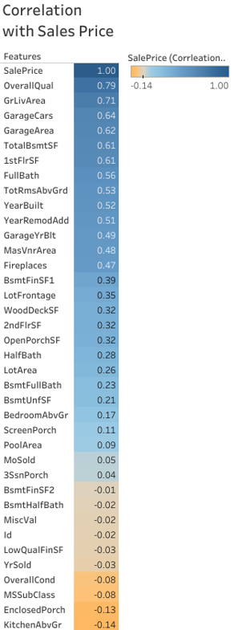
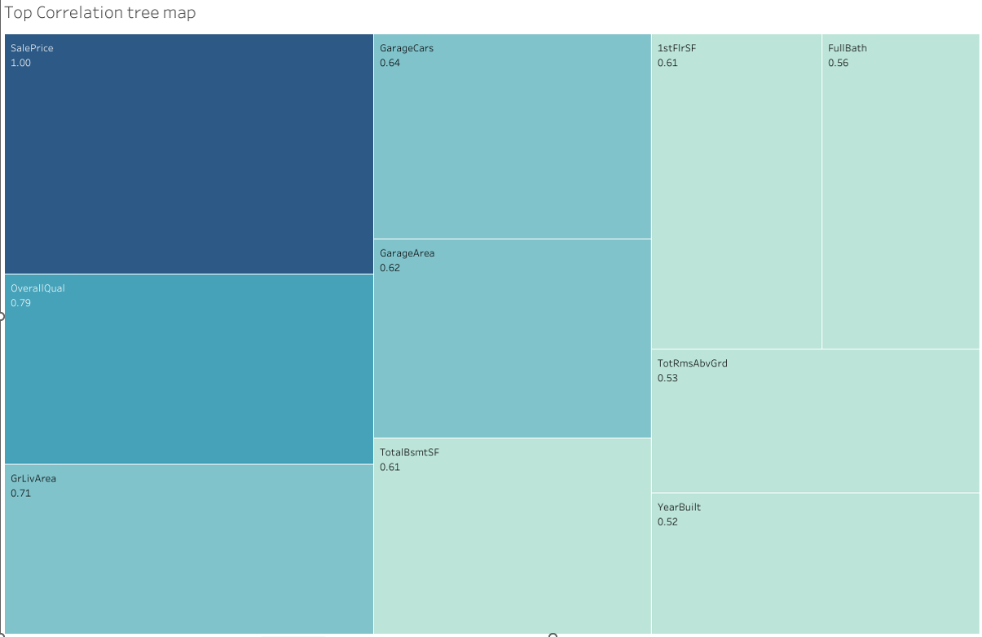
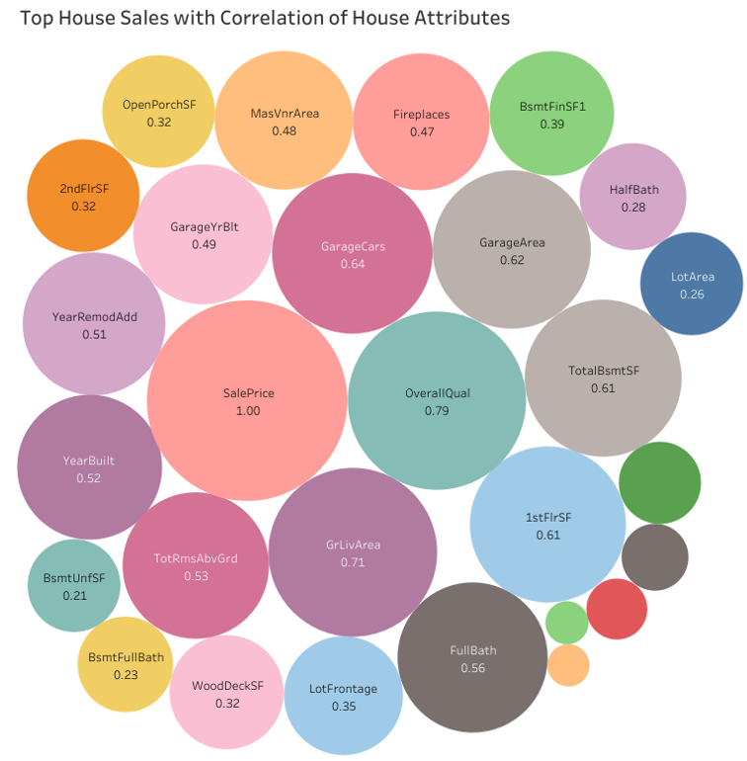
Top House Sales with Correlation to the House Attributes

Slide 36
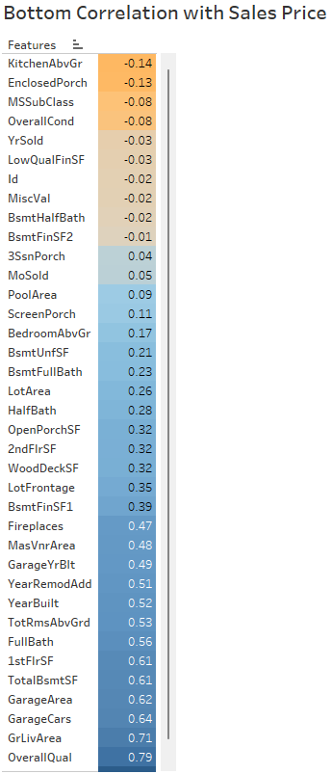
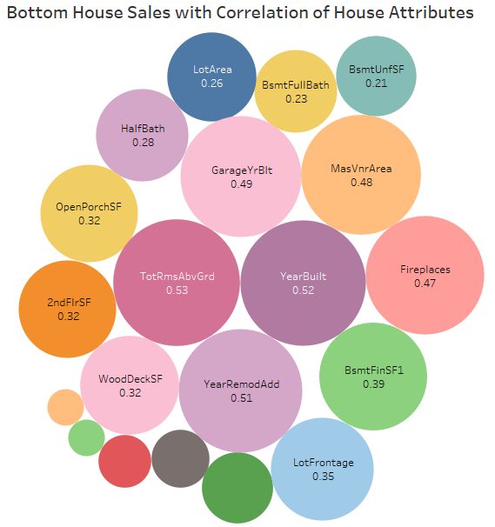
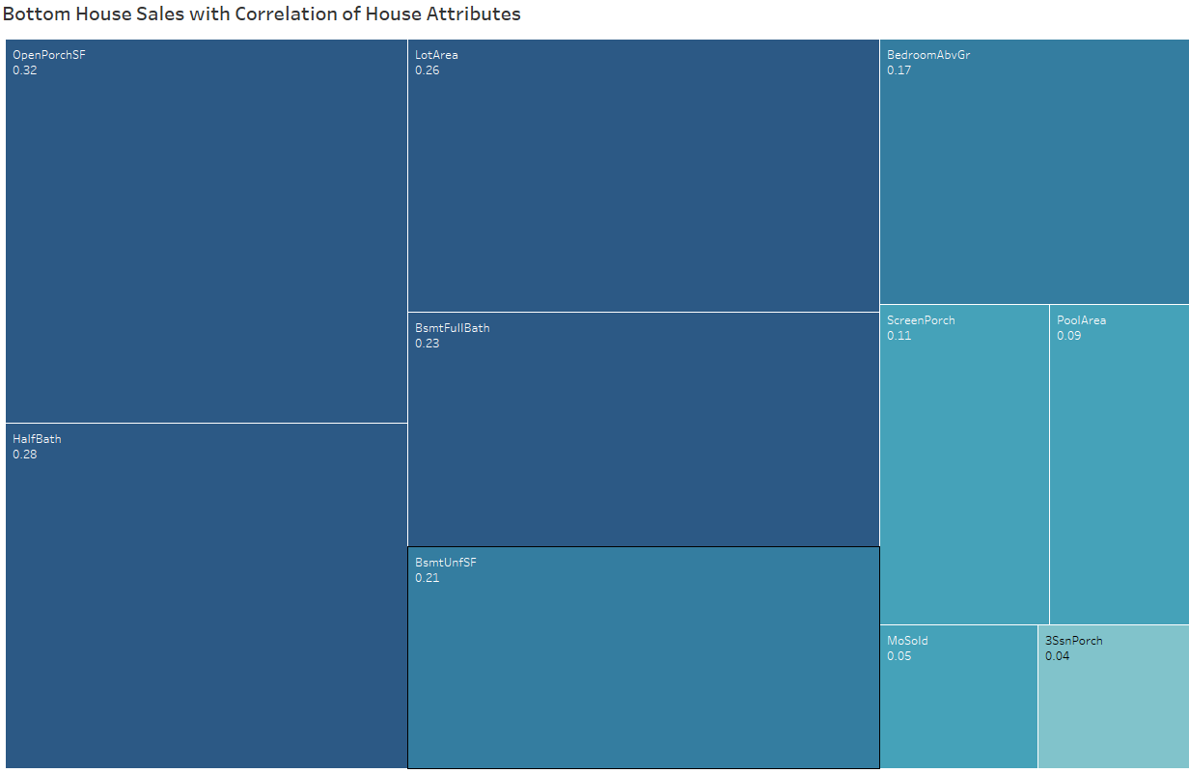
Bottom House Sales with Correlation to the House Attributes

Slide 37

“Data analytics is the future, and the future is NOW! Every mouse click, keyboard button press, swipe, or tap is used to shape business decisions. Everything is about data these days. Data is information, and information is power.” - Radi
— Congratulations Everyone!!!

Slide 38
Thank You!!!

